Slide 1

Introduction to unsafe C#
Calling native code and crashing in entirely new ways
Dennis Dietrich Senior Software Engineer, Microsoft
Rev. 6 (2023-05-??), https://github.com/dennisdietrich/UnsafeCSharp/
Notes:
Why call native code in the first place? There may not be any managed wrappers available. Existing wrappers may not provide a suitable API for your use case. You may want to create your own high-performance or platform-specific native code (out of scope for this presentation).

Slide 2
Overview
What is unsafe code?
Unsafe C# features
Memory layout
Managing unmanaged memory
Platform Invoke (P/Invoke)
Managing resource lifetime
Callbacks
Further resources

Slide 3
What is unsafe code?

Slide 4
What is unsafe code? Mutating the immutable
using StringMutation; string s = "Hello, World!"; s.AsciiToUpper(); Console.WriteLine(s); // prints "HELLO, WORLD!"
Notes:
Need to give the audience enough time to understand the code sample and its implications. When giving the presentation in-person, should ask for a show of hands if this is actually possible.

Slide 5
What is unsafe code? Code that can break the rules!
public static unsafe void AsciiToUpper(this string s) { fixed (char* p = s) for (int i = 0; i < s.Length; i++) if (p[i] >= 'a' && p[i] <= 'z') p[i] -= (char)('a' - 'A'); }
Please don‘t do this; it’s a very bad idea!

Slide 6
What is unsafe code? According to the specification:
"In unsafe code, it is possible to declare and operate on pointers, to perform conversions between pointers and integral types, to take the address of variables, and so forth. In a sense, writing unsafe code is much like writing C code within a C# program."
https://learn.microsoft.com/en-us/dotnet/csharp/language-reference/language-specification/unsafe-code

Slide 7
What is unsafe code? New bugs!
Buffer overflows
Access violations
Stack and heap corruptions
Dangling pointers
Use after free
Use after relocation
Memory leaks

Slide 8
Unsafe C# features

Slide 9
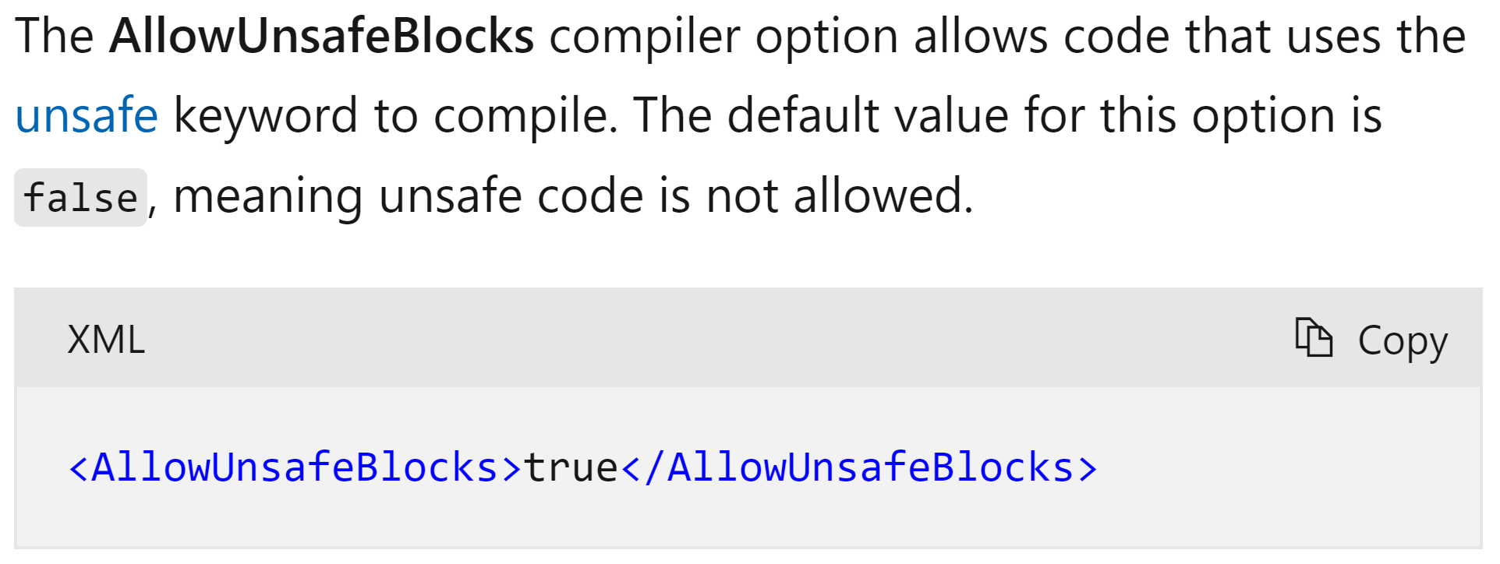
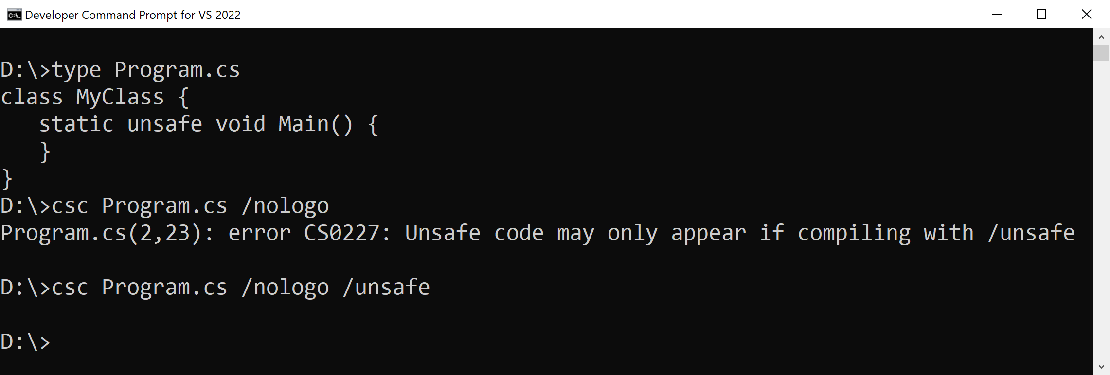
Unsafe C# features Breaking down the example
// Method is declared unsafe public static unsafe void AsciiToUpper(this string s) { // Pins string and gets address
// of first element of char array fixed (char* p = s) for (int i = 0; i < s.Length; i++) // Pointer element access if (p[i] >= 'a' && p[i] <= 'z') p[i] -= (char)('a' - 'A'); }

Slide 10
Unsafe C# features Pointer operations I
// Pin array and get pointer to first element fixed (byte* bytePtr = managedByteArray) // Pin object and get pointer to field fixed (int* intPtr = &_integer) // Get address of argument double* doublePtr = &doubleParameter; // Get address of local char* charPtr = &character; // Dereference pointer Console.WriteLine(*doublePtr);

Slide 11
Unsafe C# features Pointer operations II
Struct s = new Struct { Integer = 47, Double = 4.77 }; Struct* sPtr = &s; // Dereference pointer and access member sPtr->Integer = 42; Console.WriteLine(sPtr->Integer);

Slide 12
Unsafe C# features Pointer operations III
public static unsafe void AsciiToUpper(this string s) { fixed (char* p = s) { char* ptr = p; char* end = ptr + s.Length; // Pointer arithmetic while (ptr < end) { // Pointer comparison if (*ptr >= 'a' && *ptr <= 'z') *ptr -= (char)('a' - 'A'); ptr++; // Pointer increment } } }

Slide 13
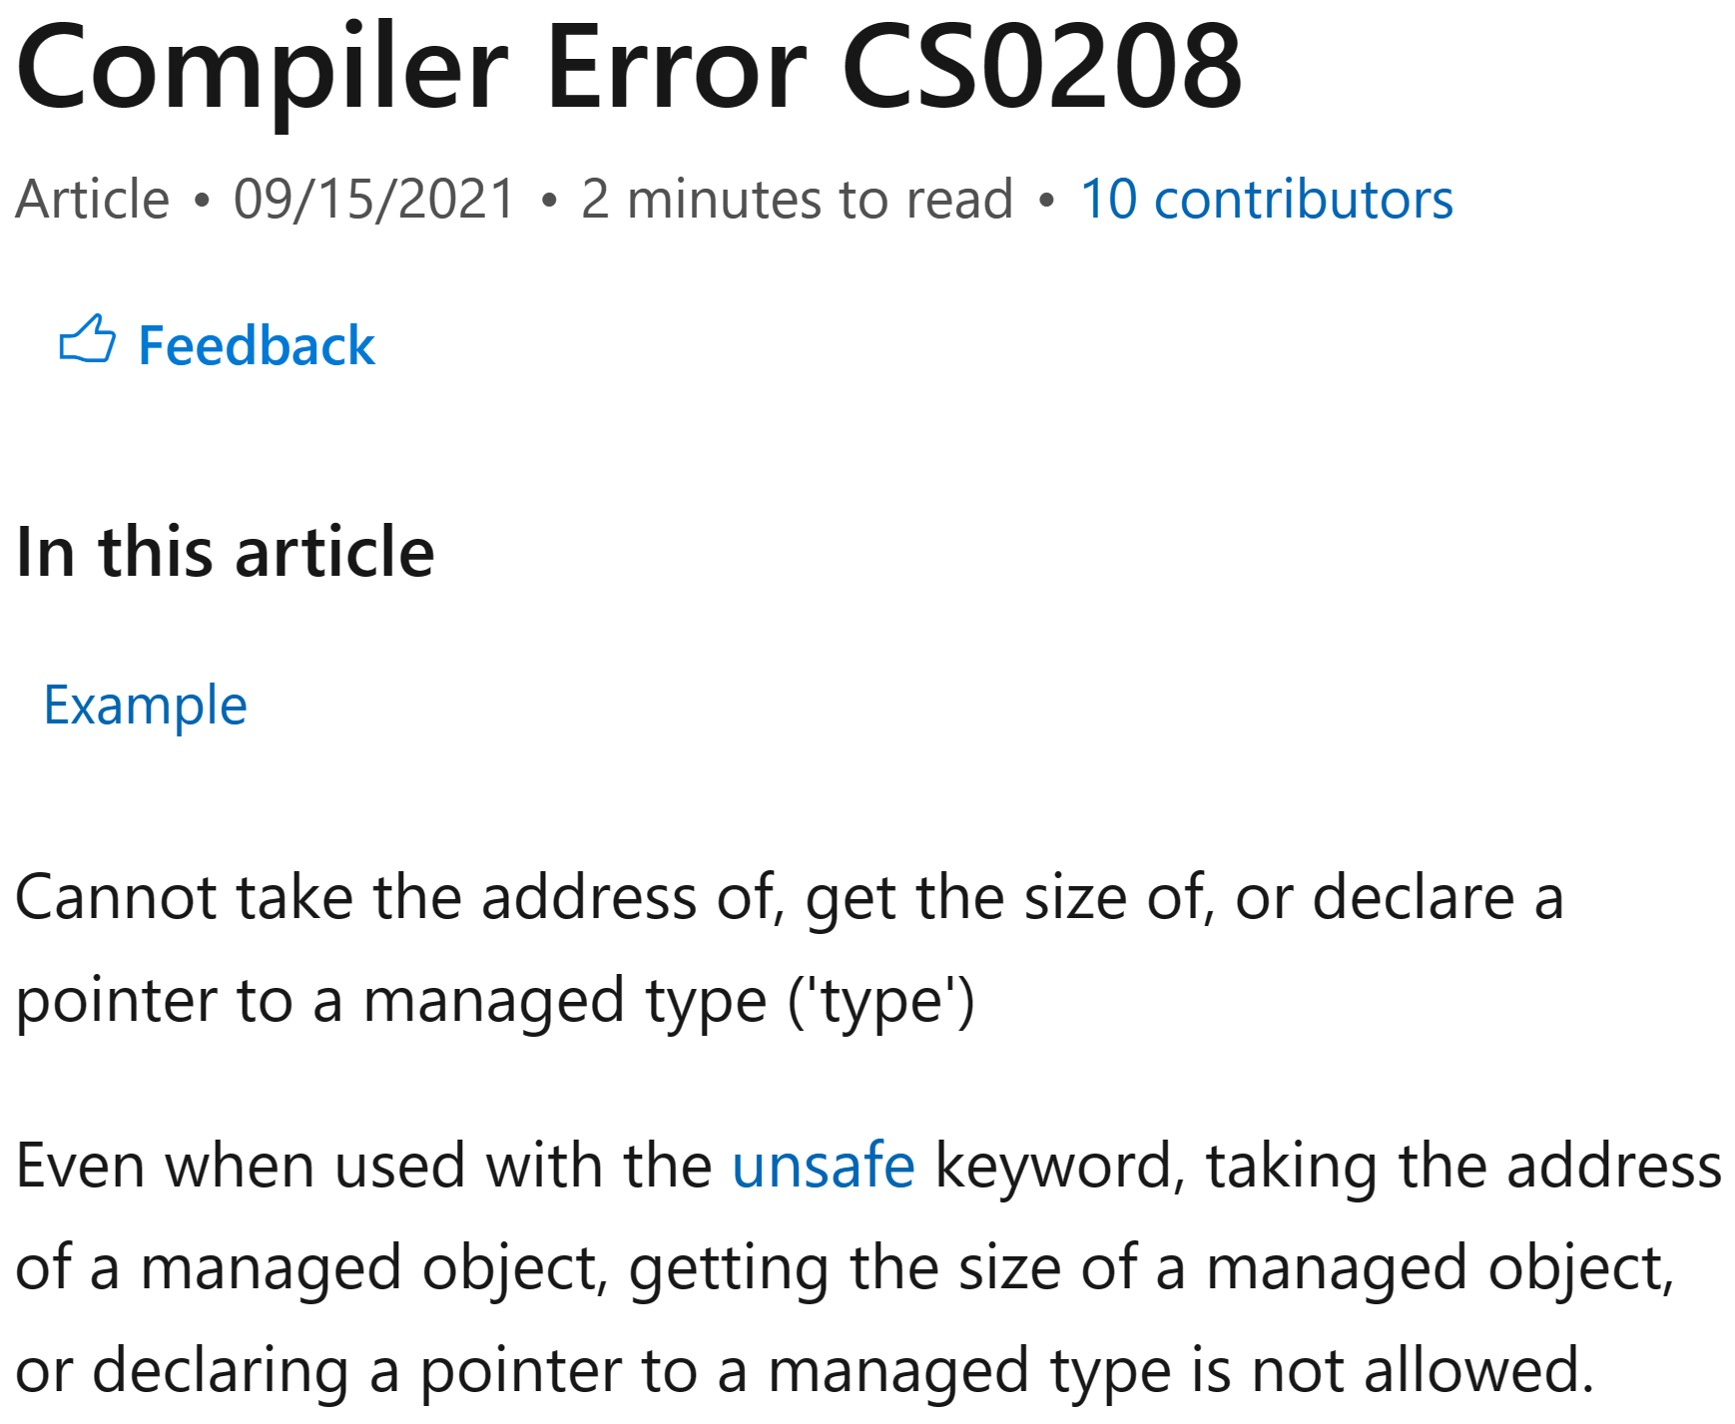
Unsafe C# features What can you get the address of?
All value types including (generic) structs…
…as long as they don‘t contain any object references
Arrays of value types
Strings (which are arrays of char)

Slide 14
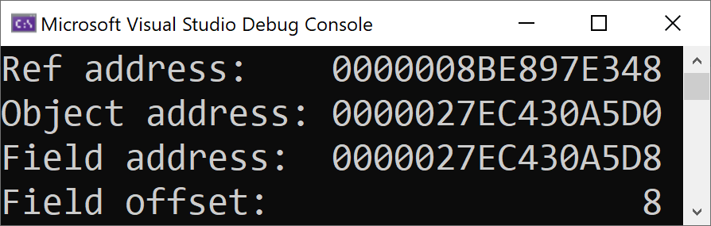
Unsafe C# features …unless you’re already using C# 11
public class ManagedType { public ushort Value = 0xBEEF; }
var managed = new ManagedType(); fixed (ushort* fieldPtr = &managed.Value) { ManagedType* objPtr = &managed; Console.WriteLine($"Ref address: {(nuint)objPtr:X16}"); Console.WriteLine($"Object address: {(nuint)(*(nuint**)objPtr):X16}"); Console.WriteLine($"Field address: {(nuint)fieldPtr:X16}"); Console.WriteLine($"Field offset: {(nuint)((byte*)fieldPtr - *(byte**)objPtr),16:X1}"); }

Slide 15
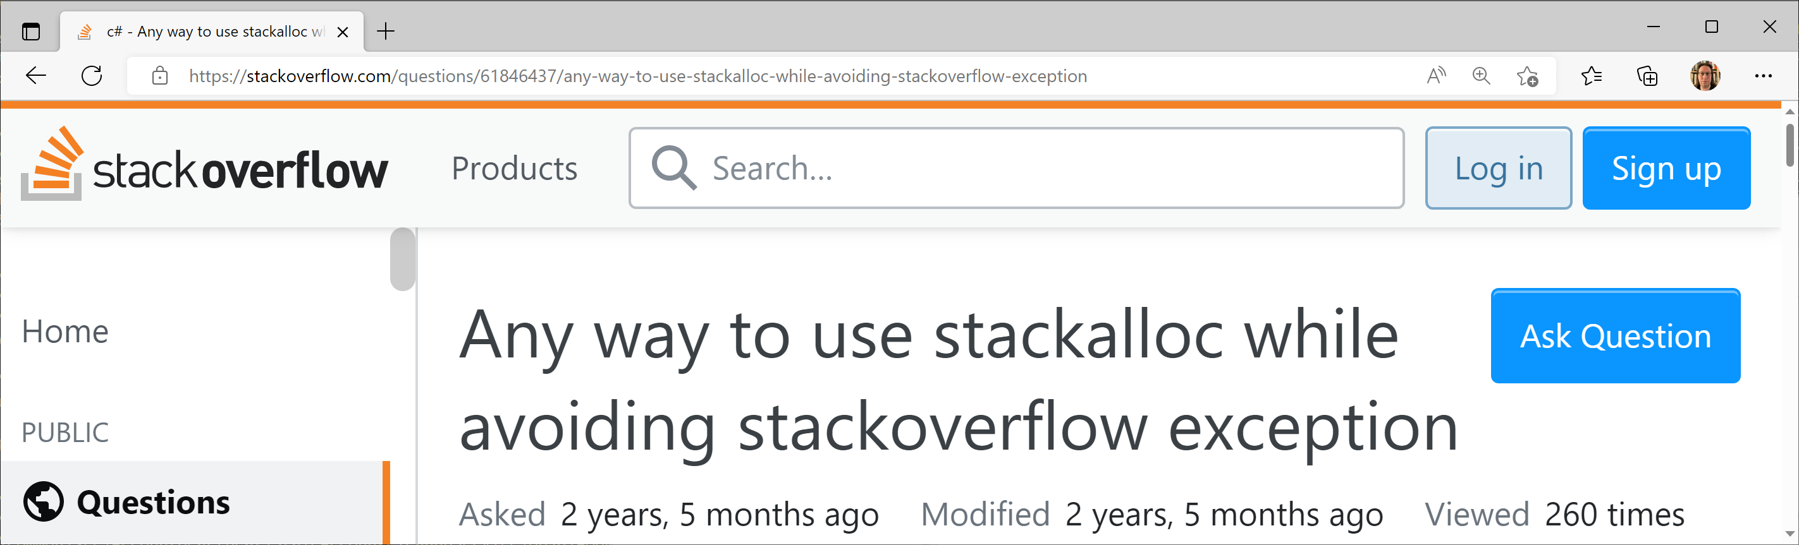
Unsafe C# features Fixed-sized buffers
// Fixed size buffer type must be one of the following: // bool, byte, short, int, long, char, sbyte,
// ushort, uint, ulong, float, double public unsafe struct FixedBuffer { public int Integer;
// Type of ByteBuffer is byte* public fixed byte ByteBuffer[128]; }
// Allocate memory from call stack and return address byte* byteArray = stackalloc byte[1024]; Guid* guidArray = stackalloc Guid[128];

Slide 16
Memory layout

Slide 17
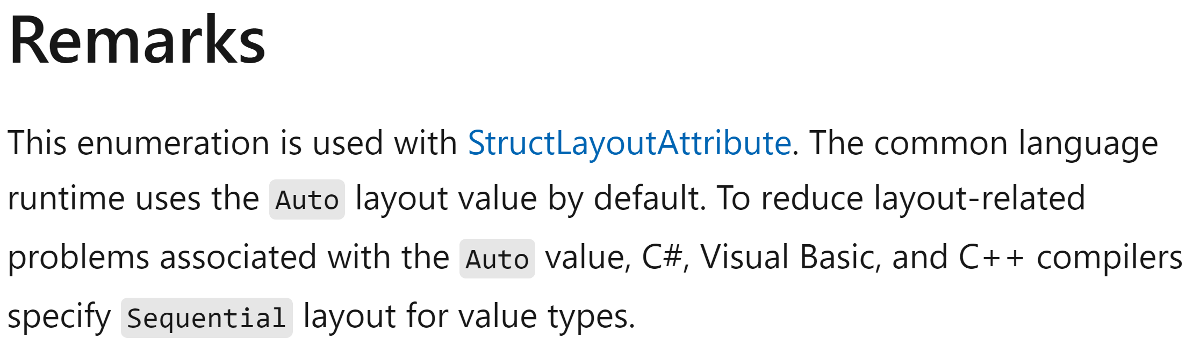
Memory layout Packing Size
// sizeof(DefaultPackingSize) = 16 public struct DefaultPackingSize { public byte B1; // offset: 0 public byte B2; // offset: 1 public long L; // offset: 8 } // sizeof(PackingSizeFour) = 12 [StructLayout(LayoutKind.Sequential, Pack = 4)] public struct PackingSizeFour { public byte B1; // offset: 0 public byte B2; // offset: 1 public long L; // offset: 4 }

Slide 18
Memory layout Explicit struct layout I
// Assuming a little-endian system [StructLayout(LayoutKind.Explicit)] public struct Union { [FieldOffset(0)] public ushort Value; [FieldOffset(0)] public byte LowByte; [FieldOffset(1)] public byte HighByte; }
Union u = new() { Value = 0xBEEF }; Console.WriteLine($"{u.HighByte:X2}"); // Prints "BE" Console.WriteLine($"{u.LowByte:X2}"); // Prints "EF"

Slide 19
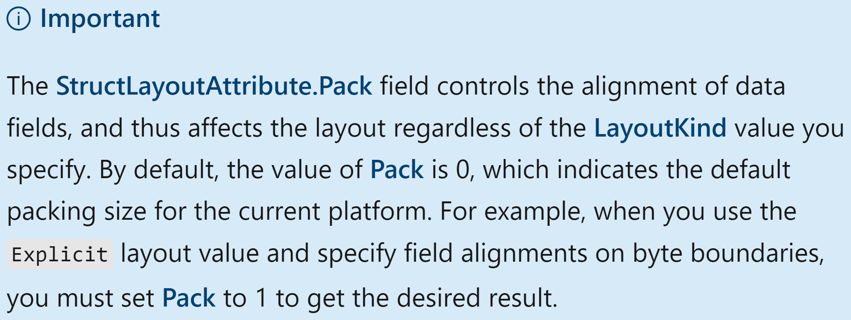
Memory layout Explicit struct layout II
[StructLayout(LayoutKind.Explicit)] public unsafe struct ReinterpretCast { [FieldOffset(0)] public long Long; [FieldOffset(0)] public double Double; [FieldOffset(0)] public void* Ptr; } ReinterpretCast c = new() { Long = 47 }; Console.WriteLine(c.Double); // Prints "2.3E-322"

Slide 20
Memory layout Explicit struct layout III
[StructLayout(LayoutKind.Explicit)] public struct ExplicitWithoutPack // sizeof(ExplicitWithoutPack) = 16 { [FieldOffset(0)] public byte B; [FieldOffset(1)] public int I; [FieldOffset(5)] public long L; } [StructLayout(LayoutKind.Explicit, Pack = 1)] public struct ExplicitWithPack // sizeof(ExplicitWithPack) = 13 { [FieldOffset(0)] public byte B; [FieldOffset(1)] public int I; [FieldOffset(5)] public long L; }

Slide 21
Managing unmanaged memory

Slide 22
Managing unmanaged memory The .NET 6 way
// Allocate heap memory using
// C standard library function malloc() void* ptr = NativeMemory.Alloc(1024); // Free heap memory using C standard library function free() NativeMemory.Free(ptr);

Slide 23
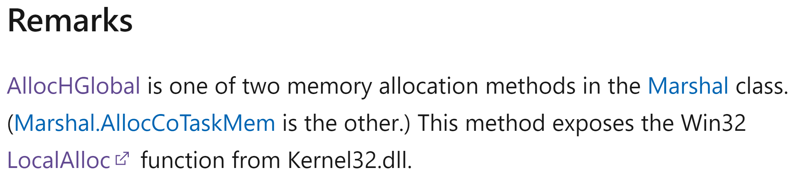
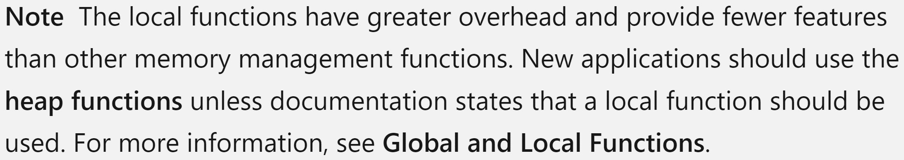
Managing unmanaged memory The .NET Framework way
// The following code is not unsafe: // Allocate memory from default heap IntPtr intPtr = Marshal.AllocHGlobal(1024); // Free memory Marshal.FreeHGlobal(intPtr);

Slide 24
Managing unmanaged memory The Win32 way
// Retrieves a handle to the default heap of the calling process.
HANDLE GetProcessHeap();
// Allocates a block of memory from a heap.
DECLSPEC_ALLOCATOR LPVOID HeapAlloc(
_In_ HANDLE hHeap,
_In_ DWORD dwFlags,
_In_ SIZE_T dwBytes);
// Frees a memory block allocated from a heap
// by the HeapAlloc or HeapReAlloc function.
BOOL HeapFree(
_Inout_ HANDLE hHeap,
_In_ DWORD dwFlags,
__drv_freesMem(Mem) _Frees_ptr_opt_ LPVOID lpMem);

Slide 25
Platform Invoke (P/Invoke)
Notes:
Platform invoke is a bit of a misnomer stemming from the fact that a primary use case in the early days of .NET was to call Win32 APIs. Of course, like the more aptly named JNI, P/Invoke can be used to call any native library (assuming supported calling conventions). Also, these days the actual platform can be macOS (and its variations) and Linux in addition to Windows.

Slide 26
Platform Invoke (P/Invoke) DLL imports
internal static class Kernel32 { internal static readonly IntPtr HeapHandle = GetProcessHeap(); [DllImport("kernel32.dll")] internal static extern IntPtr GetProcessHeap(); [DllImport("kernel32.dll")] internal static extern unsafe void* HeapAlloc(
IntPtr hHeap, uint dwFlags, nuint dwBytes); [DllImport("kernel32.dll")] internal static extern unsafe int HeapFree(
IntPtr hHeap, uint dwFlags, void* lpMem); }

Slide 27
Platform Invoke (P/Invoke) Calling external functions
using static MemoryManagement.Kernel32; unsafe { void* ptr = HeapAlloc(HeapHandle, 0, 1024); if (ptr == null) throw new OutOfMemoryException(); HeapFree(HeapHandle, 0, ptr); }

Slide 28
Platform Invoke (P/Invoke) Data type resources
Header files
The Data Type Ranges page of the C++ language reference https://learn.microsoft.com/en-us/cpp/cpp/data-type-ranges
The Windows Data Types page of the Win32 documentation https://learn.microsoft.com/en-us/windows/win32/winprog/windows-data-types

Slide 29
Platform Invoke (P/Invoke) Code generators
For Win32 APIs on .NET 6: C#/Win32 "A source generator to add a user-defined set of Win32 P/Invoke methods and supporting types to a C# project." https://github.com/microsoft/CsWin32
From C/C++ header files: SWIG "SWIG is a software development tool that connects programs written in C and C++ with a variety of high-level programming languages. […] The list of supported languages also includes non-scripting languages such as C#, D, Go language, Java including Android, Lua, OCaml, Octave, Scilab and R." https://www.swig.org
Full discloser: I haven’t used either
“We were asked to […] provide a tool that would take an unmanaged C header file and produce pinvoke declarations […]. The […] ask is unfortunately impossible to do 100% correctly since unmanaged header files are too ambiguous to be automatically convertible. For example, how would such tool convert char* parameter? As String, StringBuilder, ref char or char[]?”
- Brad Abrams
https://learn.microsoft.com/en-us/archive/blogs/brada/the-pinvoke-problem

Slide 30
Platform Invoke (P/Invoke) Calling conventions I
Argument passing to the callee
Return value passing back to the caller
Stack cleanup
Can be specified as part of the DLL import https://learn.microsoft.com/en-us/dotnet/api/system.runtime.interopservices.dllimportattribute.callingconvention

Slide 31
Platform Invoke (P/Invoke) Calling conventions II
Windows, x86 https://learn.microsoft.com/en-us/cpp/cpp/argument-passing-and-naming-conventions
Supported by .NET: __cdecl, __stdcall, __thiscall
Unsupported by .NET: __fastcall, __vectorcall
Windows, x64
Standard calling convention https://learn.microsoft.com/en-us/cpp/build/x64-calling-convention
__vectorcall convention as an extension of the standard convention (unsupported by .NET) https://learn.microsoft.com/en-us/cpp/cpp/vectorcall

Slide 32
Platform Invoke (P/Invoke) Calling conventions III
macOS, ARM64
Single calling convention https://developer.apple.com/documentation/xcode/writing-arm64-code-for-apple-platforms
Modified version of the official AArch64 Procedure Call Standard (PCS) https://developer.arm.com/documentation/102374/0100/Procedure-Call-Standard
Linux, x64
Single calling convention
Implements the AMD64 Architecture Processor Supplement of the System V Application Binary Interface specification https://refspecs.linuxbase.org/elf/x86_64-abi-0.99.pdf

Slide 33
Managing resource lifetime

Slide 34
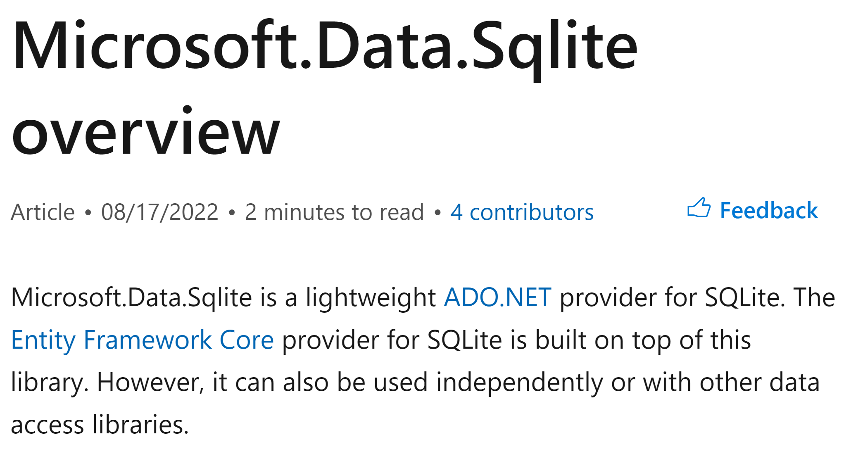
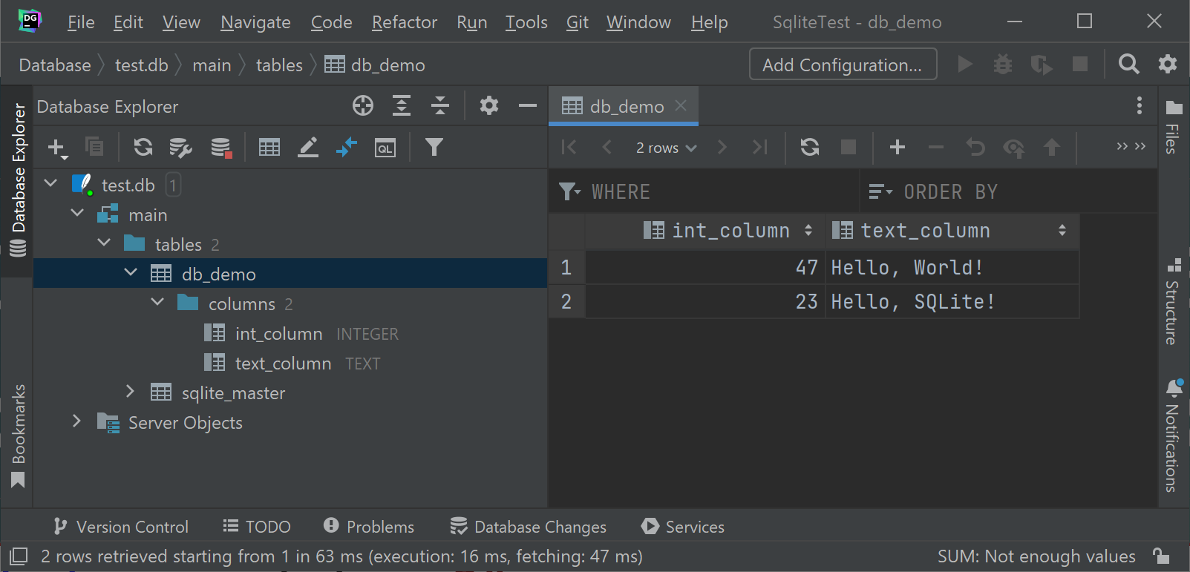
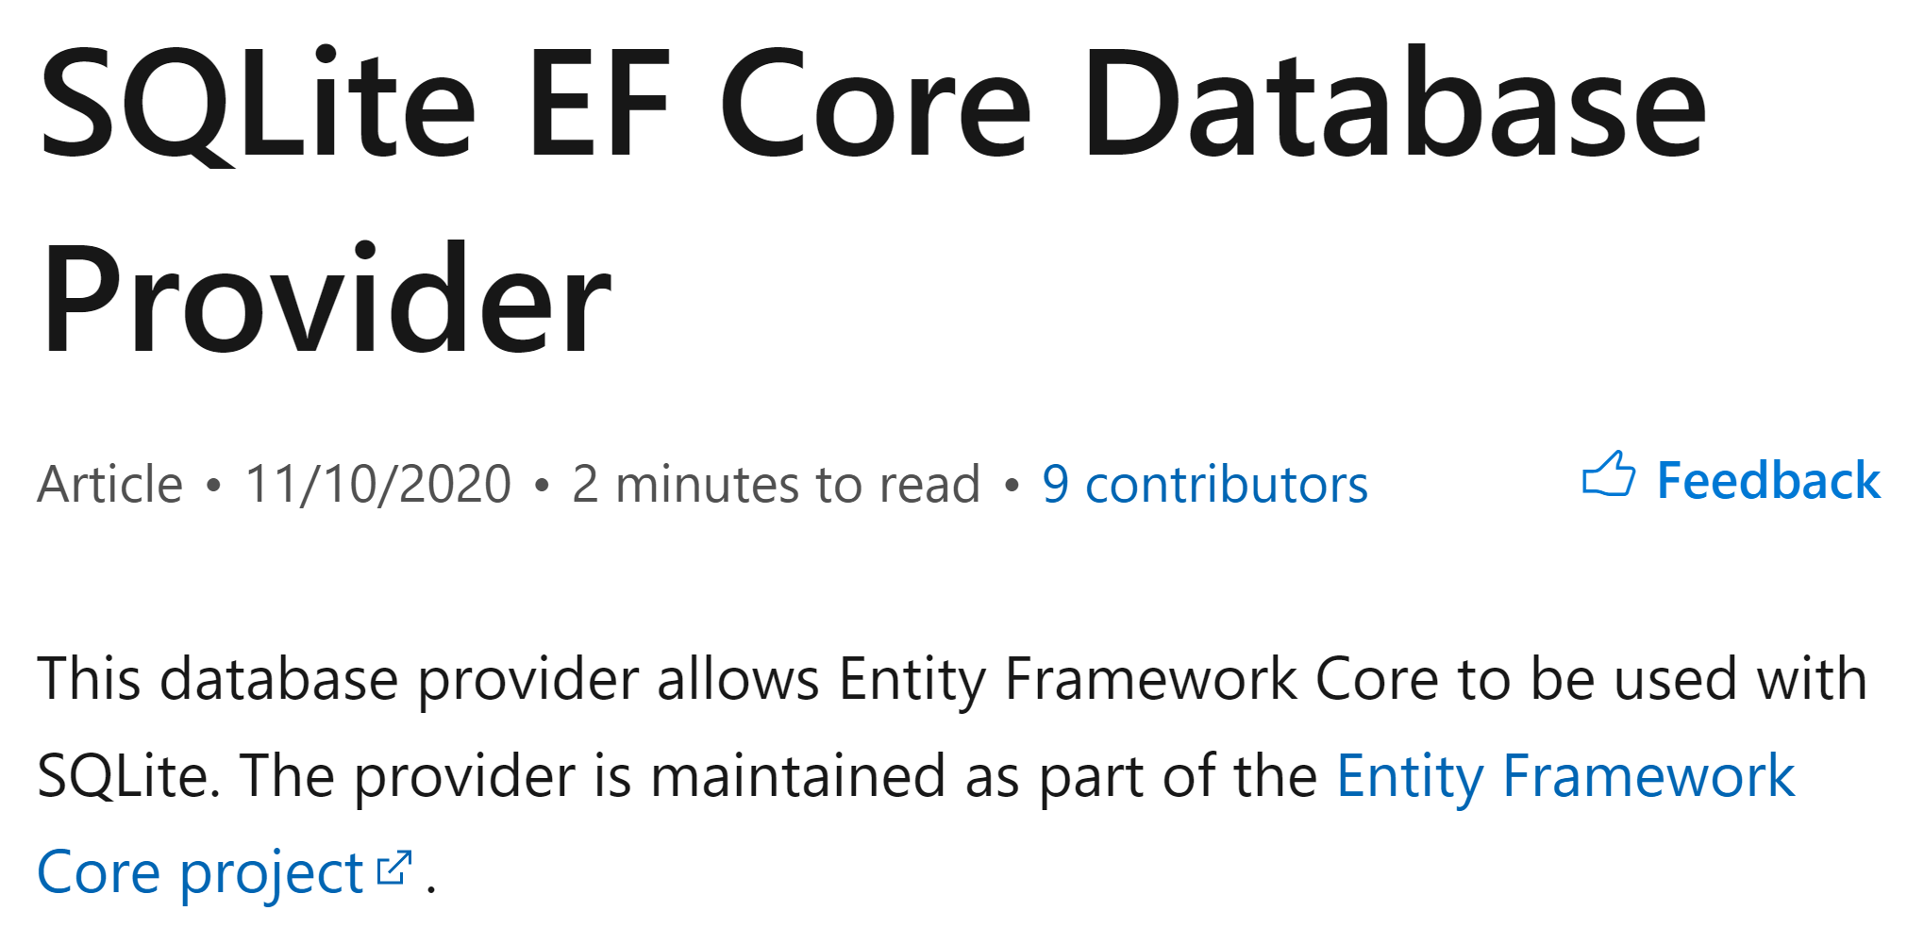
Managing resource lifetime Example: SQLite database
string script = @" CREATE TABLE db_demo (int_column INTEGER, text_column TEXT); INSERT INTO db_demo (int_column, text_column)
VALUES (47, 'Hello, World!'); INSERT INTO db_demo (int_column, text_column)
VALUES (23, 'Hello, SQLite!');"; using Database db = new Database("test.db"); db.Execute(script);

Slide 35
Managing resource lifetime SQLite API
public unsafe delegate int Callback(
void* ptr, int columns, byte** values, byte** names); [DllImport("sqlite3.dll", EntryPoint = "sqlite3_open")] internal static extern int Open(
[MarshalAs(UnmanagedType.LPUTF8Str)] string filename,
out SafeDatabaseHandle pDb); [DllImport("sqlite3.dll", EntryPoint = "sqlite3_close_v2")] internal static extern int Close(IntPtr pDb); [DllImport("sqlite3.dll", EntryPoint = "sqlite3_exec")] internal static extern unsafe int Execute(SafeDatabaseHandle pDb,
[MarshalAs(UnmanagedType.LPUTF8Str)] string sql,
Callback? callback, void* firstArg, byte** errMsg);

Slide 36
Managing resource lifetime What‘s a safe handle?
"Represents a wrapper class for operating system handles." https://learn.microsoft.com/en-us/dotnet/api/system.runtime.interopservices.safehandle
…but works just as well with pointers! :)
Is a CriticalFinalizerObject https://learn.microsoft.com/en-us/dotnet/api/system.runtime.constrainedexecution.criticalfinalizerobject
Runs finalization in a Constrained Execution Regions (.NET Framework only) https://learn.microsoft.com/en-us/dotnet/framework/performance/constrained-execution-regions
P/Invoke infrastructure reference counts usage

Slide 37
Managing resource lifetime SafeDatabaseHandle
internal sealed class SafeDatabaseHandle : SafeHandle { public override bool IsInvalid => handle == IntPtr.Zero; internal SafeDatabaseHandle() : base(IntPtr.Zero, true) { } protected override bool ReleaseHandle() =>
Sqlite.Close(handle) == 0; }

Slide 38
Managing resource lifetime Database wrapper class I
public sealed class Database : IDisposable { private readonly SafeDatabaseHandle _databaseHandle; public Database(string filename) { if (Sqlite.Open(filename, out _databaseHandle) != 0) throw new Exception("Failed to open database."); } // Look mom! No finalizer!

Slide 39
Managing resource lifetime Database wrapper class II
public unsafe void Execute(string sql, Callback? callback = null) { // Look mom! No 'disposed' check! if (Sqlite.Execute(
_databaseHandle, sql, callback, null, null) != 0) throw new Exception("Script execution failed."); } // No need for overloads since the class is sealed. public void Dispose() { if (_databaseHandle.IsInvalid == false) _databaseHandle.Dispose(); } }
Always call Dispose().
Do not rely on the finalizer.

Slide 40
Callbacks

Slide 41
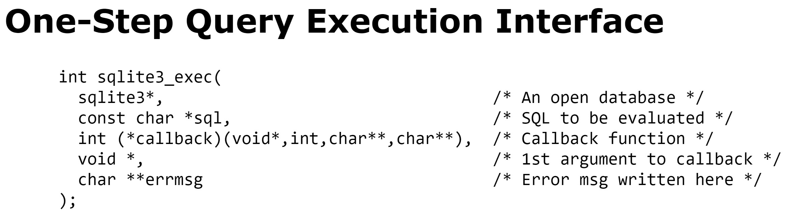
Callbacks The .NET Framework way I
public unsafe delegate int Callback(
void* ptr, int columns, byte** values, byte** names); [DllImport("sqlite3.dll", EntryPoint = "sqlite3_open")] internal static extern int Open(
[MarshalAs(UnmanagedType.LPUTF8Str)] string filename,
out SafeDatabaseHandle pDb); [DllImport("sqlite3.dll", EntryPoint = "sqlite3_close_v2")] internal static extern int Close(IntPtr pDb); [DllImport("sqlite3.dll", EntryPoint = "sqlite3_exec")] internal static extern unsafe int Execute(SafeDatabaseHandle pDb,
[MarshalAs(UnmanagedType.LPUTF8Str)] string sql,
Callback? callback, void* firstArg, byte** errMsg);

Slide 42
Callbacks The .NET Framework way II
public unsafe void Execute(string sql, Callback? callback = null) { if (Sqlite.Execute(
_databaseHandle, sql, callback, null, null) != 0) throw new Exception("Script execution failed."); }

Slide 43
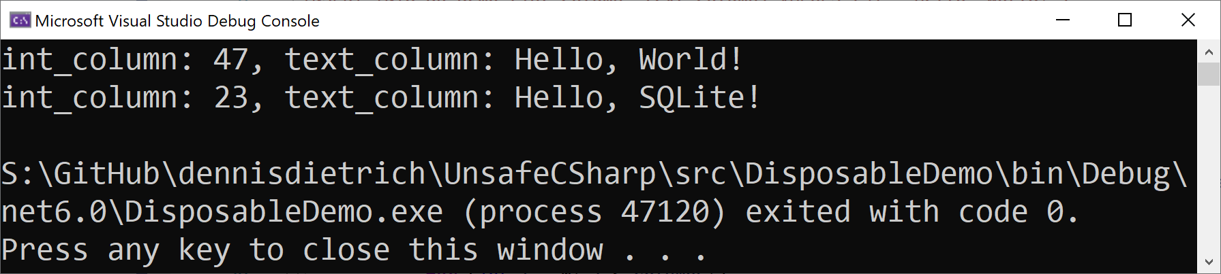
Callbacks The .NET Framework way III
db.Execute("SELECT int_column, text_column FROM db_demo;",
(_, columns, values, names) => { try { for (int i = 0; i < columns;) { Console.Write($"{FromUtf8(names[i])}: {FromUtf8(values[i])}"); Console.Write(++i == columns ? Environment.NewLine : ", "); } return ResultCode.Ok; } catch { return ResultCode.Error; } });

Slide 44
Callbacks Callback delegate lifetime I
void (*callbackPtr)(void) = NULL;
__declspec(dllexport) void __stdcall SetCallback(void (*ptr)(void));
__declspec(dllexport) void __stdcall CallMeMaybe(void);
void SetCallback(void (*ptr)(void))
{
callbackPtr = ptr;
}
void CallMeMaybe(void)
{
callbackPtr();
}

Slide 45
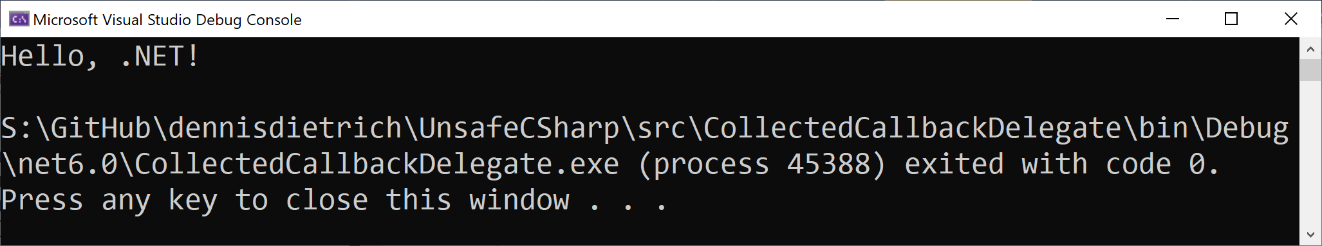
Callbacks Callback delegate lifetime II
static void SetupAndTriggerNativeCallback() { static void SayHello() => Console.WriteLine("Hello, .NET!"); SetCallback(SayHello); CallMeMaybe(); } SetupAndTriggerNativeCallback();

Slide 46
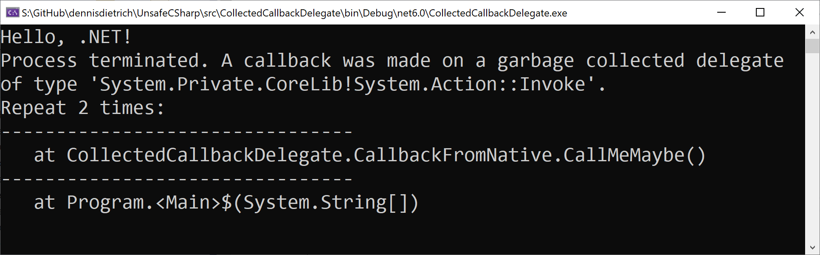
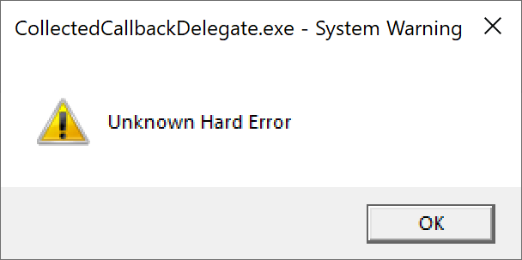
Callbacks Callback delegate lifetime III
GC.Collect(); GC.WaitForPendingFinalizers(); try { CallMeMaybe(); } catch (Exception e) { Console.WriteLine(
"Callback threw exception of type {0}: {1}",
e.GetType().FullName,
e.Message); }

Slide 47
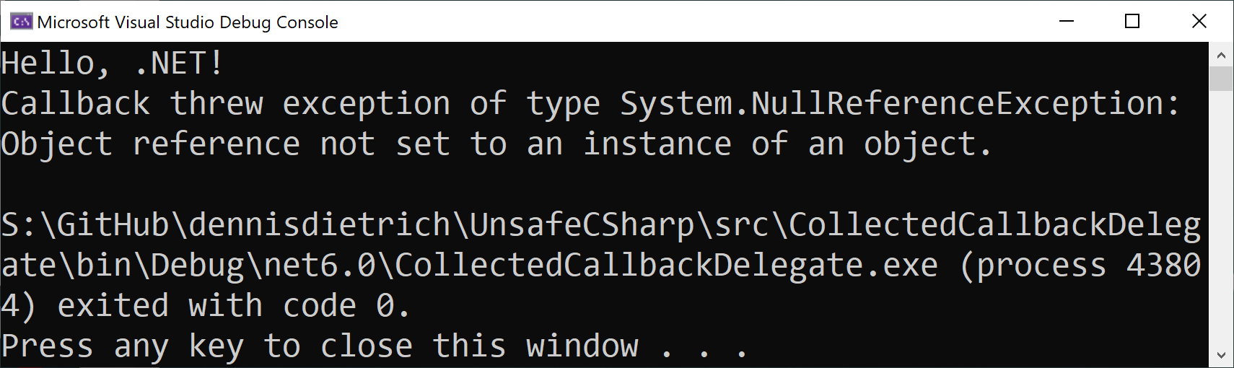
Callbacks Callback delegate lifetime IV
SetupAndTriggerNativeCallback(); GC.Collect(); // Let's not wait for the finalizers try { CallMeMaybe(); } catch (Exception e) { Console.WriteLine(
"Callback threw exception of type {0}: {1}",
e.GetType().FullName,
e.Message); }

Slide 48
Callbacks The .NET 5 way I
[DllImport("sqlite3.dll", EntryPoint = "sqlite3_exec")] internal static extern unsafe int Execute(
SafeDatabaseHandle pDb,
[MarshalAs(UnmanagedType.LPUTF8Str)] string sql,
delegate* unmanaged[Cdecl]
<void*, int, byte**, byte**, ResultCode> callback,
void* firstArg, byte** errMsg);

Slide 49
Callbacks The .NET 5 way II
public unsafe void Execute(
string sql,
delegate* unmanaged[Cdecl]
<void*, int, byte**, byte**, ResultCode> callback) { if (Sqlite.Execute(
_databaseHandle, sql, callback, null, null) != 0) throw new Exception("Script execution failed."); }

Slide 50
Callbacks The .NET 5 way III
unsafe { db.Execute("SELECT int_column, text_column FROM db_demo;", &PrintRow); } [UnmanagedCallersOnly(CallConvs = new[] { typeof(CallConvCdecl) })] static unsafe ResultCode PrintRow(
void* ptr, int columns, byte** values, byte** names) { try { for (int i = 0; i < columns;) { Console.Write($"{FromUtf8(names[i])}: {FromUtf8(values[i])}"); Console.Write(++i == columns ? Environment.NewLine : ", "); } return ResultCode.Ok; } catch { return ResultCode.Error; } }

Slide 51
Further resources

Slide 52
Further resources Microsoft Learn
Unsafe code, pointer types, and function pointers https://learn.microsoft.com/en-us/dotnet/csharp/language-reference/unsafe-code
Unsafe code (C# language specification) https://learn.microsoft.com/en-us/dotnet/csharp/language-reference/language-specification/unsafe-code
Native interoperability https://learn.microsoft.com/en-us/dotnet/standard/native-interop/

Slide 53



Questions?
dennisdietrich
dcdietrich
@dc@social.advancedsoftware.engineering

Slide 54
Thanks for listening!
dennisdietrich
dcdietrich
@dc@social.advancedsoftware.engineering

